Slide 1
Anthropometry –The fundamentals

Slide 2
Universally applicable, inexpensive and non -invasive method
For assessing size, proportion and composition of human body
Marker overall welfare larger level-predict performance ,health and survival of a population

Slide 3
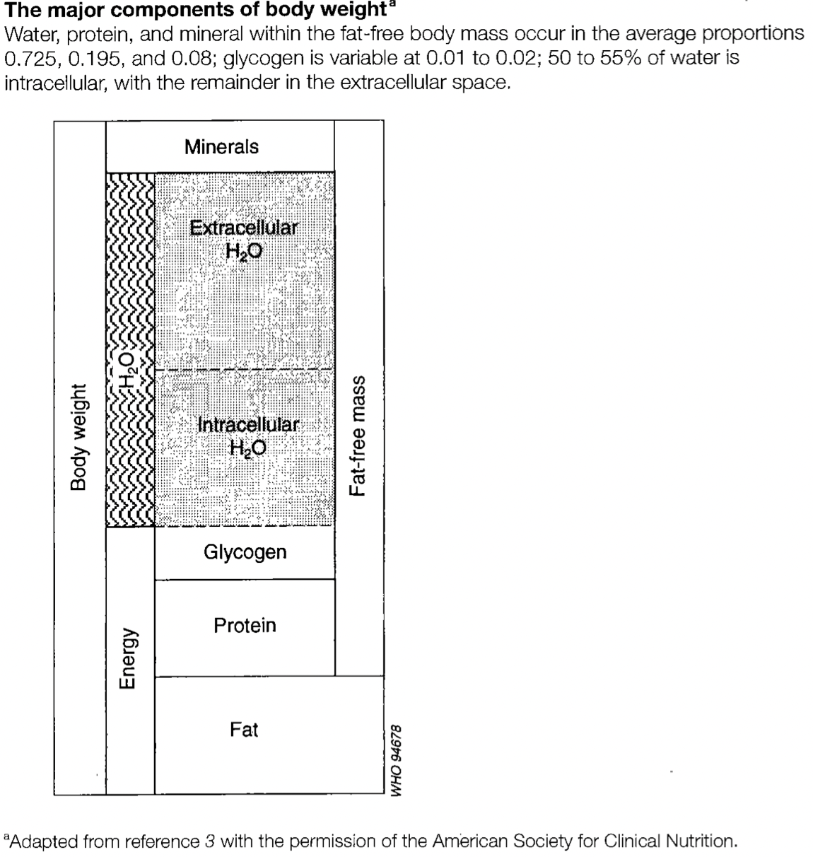
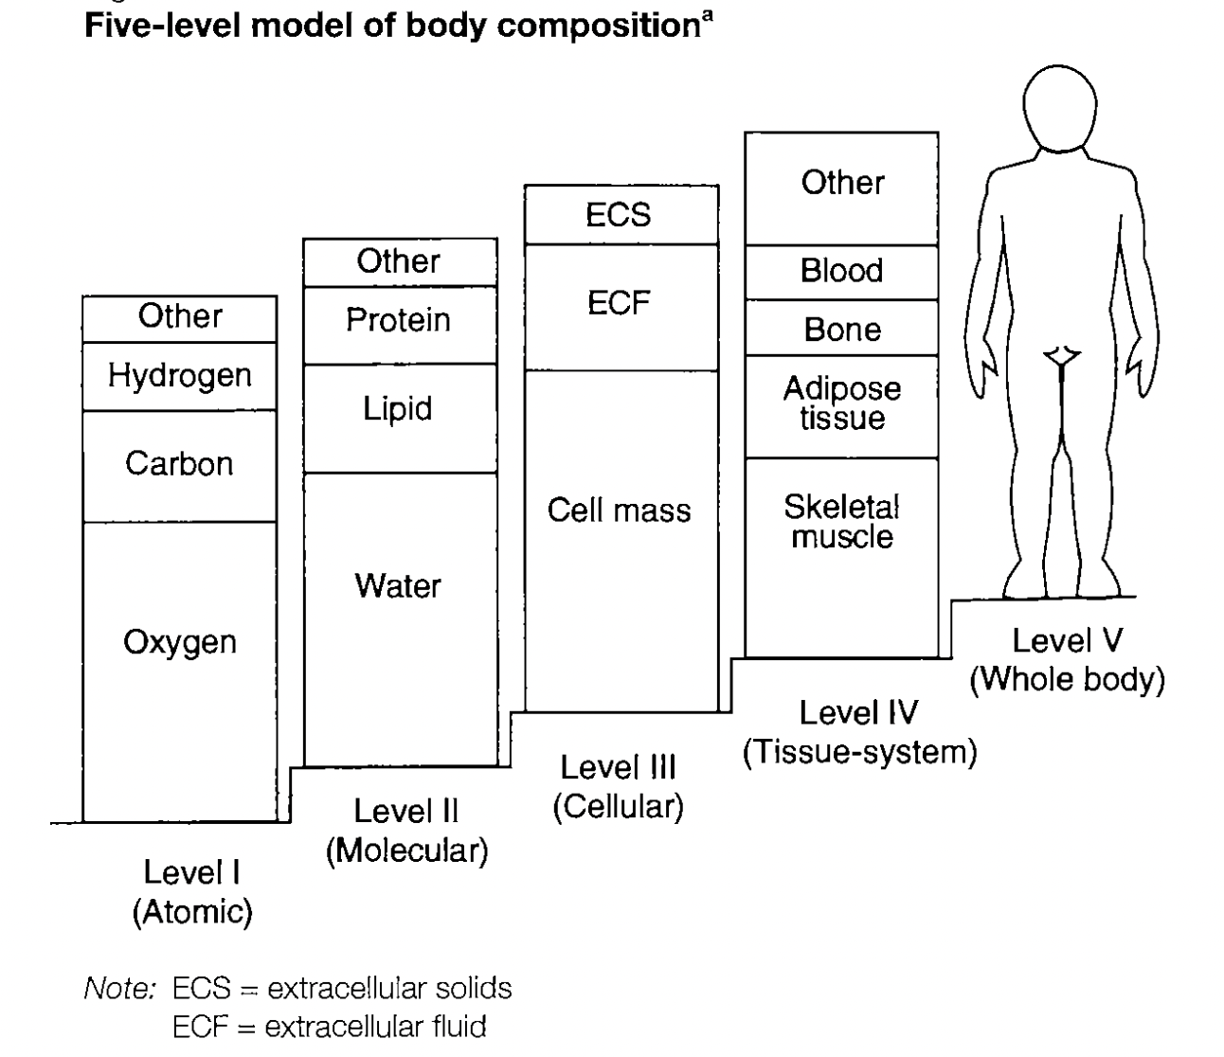
Levels- body composition
Age
Disease
Stable quantitative relationship and proportion

Slide 4
Measurement Indices Indicators
Weight & Height W/H² % of individual with a BMI <18
Indices Expression
Z-score
Percentile
Percent of Median

Slide 5

Z- score

Slide 6
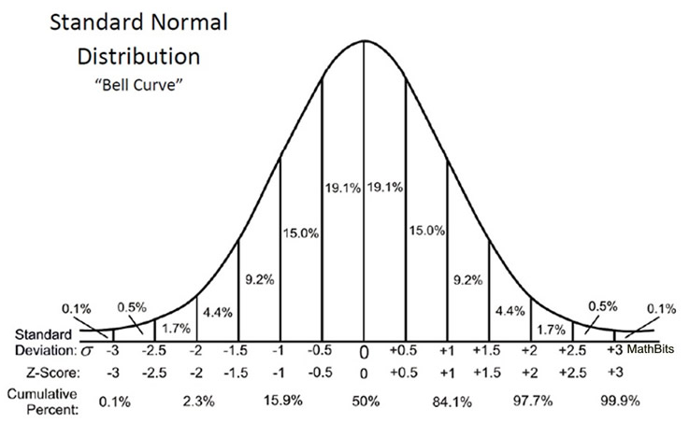
Percentile
A male child / age 6 years /weight- 10th Percentile????
Clinical settings
Concerns-
1. male child / age 6 years /weight- 10th Percentile= male child / age 6 years /weight- 20th Percentile =
male child / age 6 years /weight- 30th Percentile
(TRUE OR FALSE)
…..inappropriate to calculate summary statistics
2. The resistance of extremities

Slide 7
Percentage of Median(POM)
Ratio??
Numerator??
Denominator ??
1 80% POM might be above or below -2 Zscore
(TRUE OR FALSE)
…..different classification of risk
2 a cut off -2 Z score for POM will be equal for W/H and H/age
(TRUE OR FALSE)
………typical cut offs are different for different population

Slide 8
At a glance……..
Traits | Z score | Percentile | Percent of Median
Adherence to reference distribution | YES | YES | NO
Linearity permitting summary statistics | YES | NO | YES
Uniform criteria across indices | YES | YES | NO
Utility to detect changes at the extremities | YES | NO | YES

Slide 9
Selections of anthropometric indicators-Purpose &Objectives
At risk identification (individual/population)-identify ??
Selection of individuals /populations for an intervention-identify??
Evaluation the effect of any intervention
Excluding the individuals from high –risk treatments or from employment
Achieving normative standard
Surveillance and monitoring

Slide 10
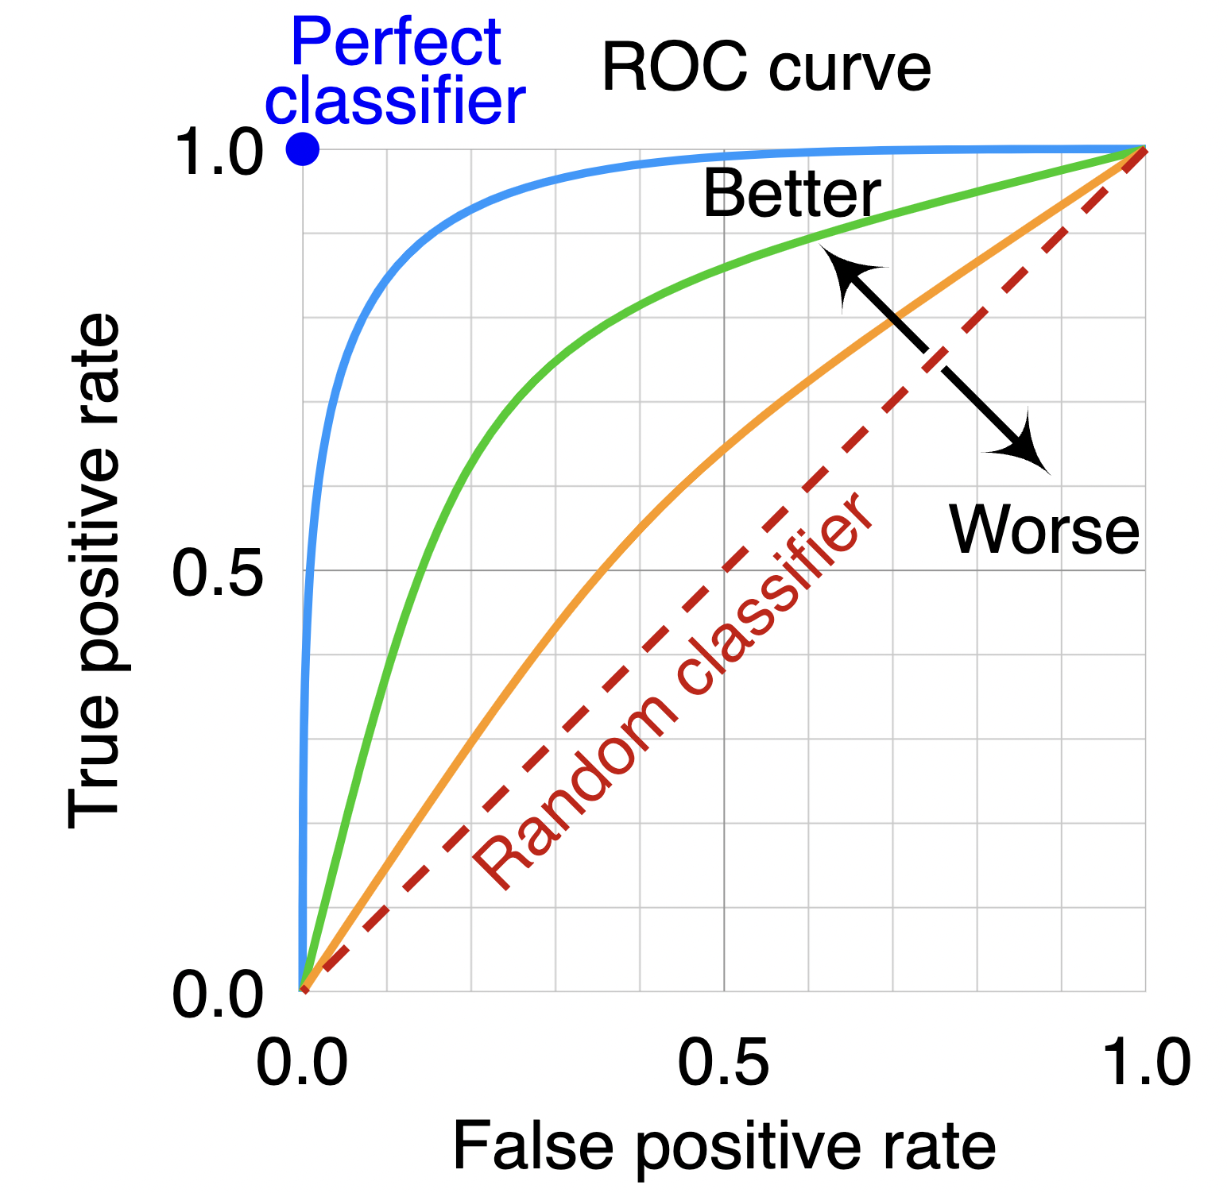
Selection of the best indicator
Objective of the indicator
Inherent property of discrimination –
How cut-off are decided??????
Sen/Sp/PPV/NPV –what is important?

Slide 11
Reference Versus Standard
Reference = Standard (TRUE or FALSE)
Example- Height distributions amongst children derived from healthy population
Healthy
D
C+ living healthily as per present prescription
A
Healthy environment
B
A+ no overtly sick individual
C
Demonstrated longevity

Slide 12
Criteria for reference population
>200 participants from each age and both sex
cross sectional data longitudinal extrapolation?
“………the World Health Organization has completed measurements and analysis for a new reference population of children living in six countries (Brazil, United States, Norway, Ghana, Oman, and India). Unlike in the first reference population, children in the new reference population were closely monitored to ensure they had optimal nutrition and health. For example, they were all exclusively breastfed for at least 4 months and were up-to-date on their vaccinations. As a result, these children are thought to demonstrate the ideal growth possible in young children. For this reason, this population is often called a standard population instead of a reference population.”

Slide 13
How these reference centile curves are obtained?
Demystifying LMS and BCPE Methods of Centile Estimation

